Slide 1
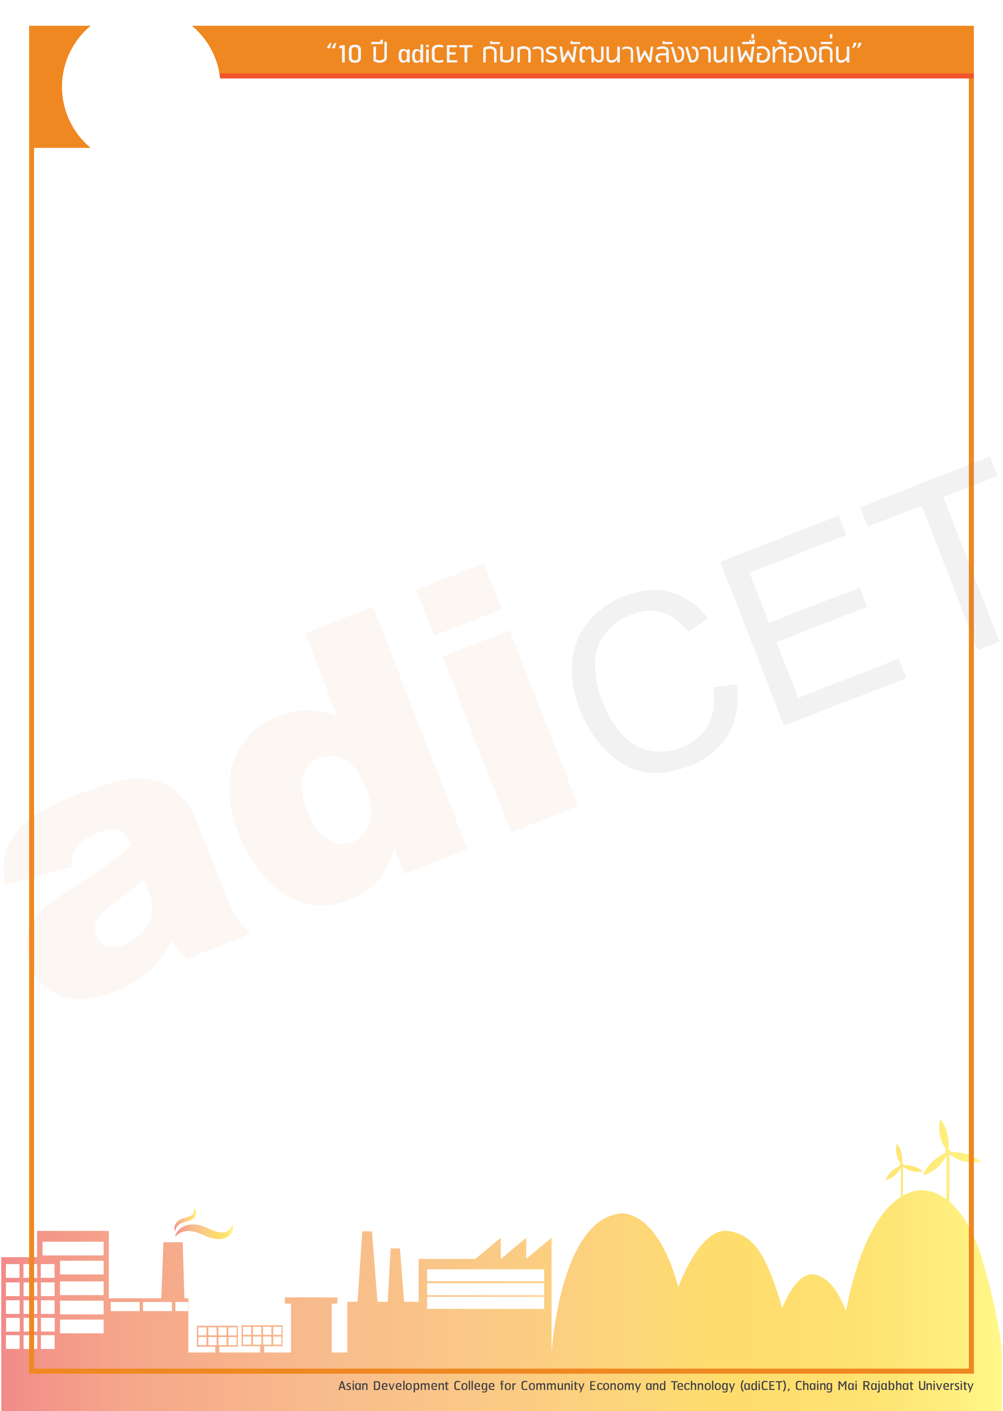




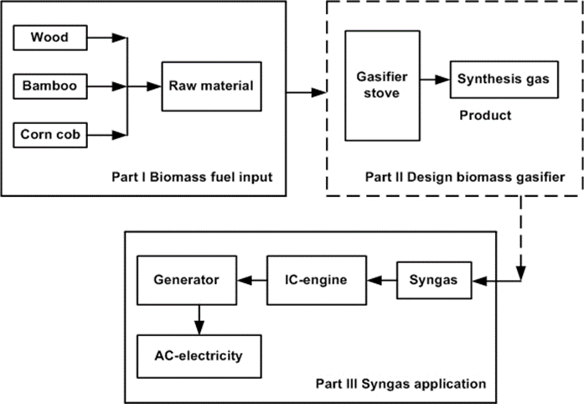

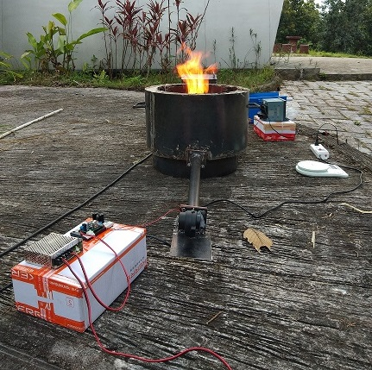
ENHANCING BIOMASS GASIFIER EFFCIENCY BY PREHEATED POROUS MEDIUM
Paitoon Laodee, Worajit Setthapun, Chayanon Sawatdeenarunat
Asian Development College for Community Economy and Technology, Chaing Mai Rajabhat University, Thailand.
Key Findings
Preliminary Results
1. Biomass gasifier stove.
2. The Porous medium combustion, CMP.
3. Air-preheat for combustion reduction zone.
The biomass combustion characteristics of the biomass stove combined with the PCM is showed in figure 3. The combustion suddenly started at the beginning of the experiment with the temperature of 31 oC and the corn cob biomass fuel can be ignited without bamboo chips. The combustion chamber had the maximum temperature, the top position of porous medium chamber temperature, and the bottom position of porous medium chamber temperature, of 1049 oC, 485 oC, 423 oC, respectively. The total mass of corn cob was 16.38 kg which could be burnt in 2 hours. The generated ash was 126 g. Then the fuel consumption rate was 8.19 kg/hr., the percentage of produced char was 7.69 % of the total corn cob weight. The percentage of char was higher than that of the non-porous stove because the corn cob has a higher moisture content. The power input and output were 0.152 MJ/hr. and 63.28 MJ/hr., respectively.
Introduction
In this research concerning to enhance the biomass gasification efficiency with to design the combustion chamber has a high temperature combine with a porous medium for air-pre-heated. The high temperature has effect to the high combustion rate and high devolatilize of a biomass fuel. Including to the porous medium combusting technology can be keep energy storage and also to radiate emission.
Conceptual Framework
By flowing figure 1. First part is preparing biomass fuel. Second part is to design biomass gasifier and last part is the internal combustion engine, IC-engine combine with the generator. This research concerning as a second part only because of syngas components and syngas properties is importance of fuel for the internal combustion engine.
Figure 3. Temperature profiles of the combustion chamber as a porous medium.
Conclusion
The air-preheating by the PMC has a clear positive effect by increasing the combustion temperature. Moreover, the PMC can store the heat energy and discharge it to the biomass combustion chamber. The power input and power output of the stove with PMC was higher than those of the Non-PMC stove. The results from this study could be served as a preliminary information for developed the high-efficiency biomass stove.
Figure 1. Conceptual research of biomass gasifier
Research Methodology
To study literature review of the biomass gasification and porous medium combustion, for Design a biomass stove and Experimental. First, to make biomass stove as showed Figure 2.
References
1] Doherty, W., Reynolds, A., & Kennedy, D. (2009). The effect of air preheating in a biomass CFB gasifier using ASPEN Plus simulation. Biomass and Bioenergy, 33(9), 1158–1167. https://doi.org/10.1016/j.biombioe.2009.05.00
[2] Rupesh, S., Muraleedharan, C., & Arun, P. (2016). ASPEN plus modelling of air–steam gasification of biomass with sorbent enabled CO2 capture. Resource-Efficient Technologies, 2(2), 94–103. https://doi.org/10.1016/j.reffit.2016.07.002
[3] Zhang, X., Li, H., Zheng, L., Chen, Z., & Qin, C. (2017). Combustion characteristics of porous media burners under various back pressures. Natural Gas Industry, 37(2), 97–102. https://doi.org/10.3787/j.issn.1000-0976.2017.02.013.
[4] Jukjai, S. (2004). "Combustion." chulalongkorn University.
Acknowledgement
Figure 2. Biomass stove building

